Slide 1

Cancer Screening Guidelines
Courtney Buys
Montana Cancer Coalition Spring Meeting 2017
Notes:
Get a feel for the room:
Raise your hand if you are:
-Clinical Staff
Administrative Staff
Folks who are interested in Cancer
Other

Slide 2

Cancer Burden in Montana
5,600 Montanans are diagnosed with cancer yearly
1,900 Montanans die from cancer yearly
53,000 Montanans are cancer survivors
Prostate, breast, lung, and colorectal cancer account for 50% of all incident cancers and 48% of cancer deaths in Montana
Montana Department of Public Health and Human Services, Montana Central Tumor Registry, 2009-2013
Notes:
Montana’s cancer burden is comparable to other states in the US.
Sources from DPHHS, Death Records, and National Cancer Institute and CDC State Profiles

Slide 3




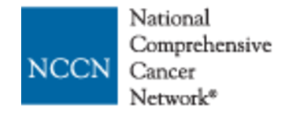




Cancer Screening Guidelines
Notes:
Multiple different types of guidelines: American Cancer Society. US Preventative Task Force
Different reporting requirements: UDS

Slide 4
Breast Cancer Screening
USPSTF Guidelines:
  Recommends biennial screening mammography for women aged 50 to 74 years
  USPSTF urges that the decision to start screening mammography in women prior to age 50 years should be an individual one. Women who place a higher value on the potential benefit than the potential harms may choose to begin biennial screening between the ages of 40 and 49 years
  The USPSTF concludes that the current evidence is insufficient to assess the balance of benefits and harms of screening mammography in women aged 75 years or older
ACS Guidelines:
  Women ages 40-44 should have the choice to start annual breast cancer screening with mammograms (x-rays of the breast)
  Women ages 45-54 should get mammograms every year
  Women 55 and older should switch to mammograms every 2 years, or can continue yearly screening
  Screening should continue as long as a woman is in good health and is expected to live 10 more years or longer
Notes:
- This is a C Grade: For women who are at average risk for breast cancer, most of the benefit of mammography results from biennial screening during ages 50 to 74 years. Of all of the age groups, women aged 60 to 69 years are most likely to avoid breast cancer death through mammography screening. While screening mammography in women aged 40 to 49 years may reduce the risk for breast cancer death, the number of deaths averted is smaller than that in older women and the number of false-positive results and unnecessary biopsies is larger. The balance of benefits and harms is likely to improve as women move from their early to late 40s.
• In addition to false-positive results and unnecessary biopsies, all women undergoing regular screening mammography are at risk for the diagnosis and treatment of noninvasive and invasive breast cancer that would otherwise not have become a threat to their health, or even apparent, during their lifetime (known as “overdiagnosis”). Beginning mammography screening at a younger age and screening more frequently may increase the risk for overdiagnosis and subsequent overtreatment.
• Women with a parent, sibling, or child with breast cancer are at higher risk for breast cancer and thus may benefit more than average-risk women from beginning screening in their 40s.
Go to the Clinical Considerations section for information on implementation of the C recommendation.
-The USPSTF concludes that the current evidence is insufficient to assess the balance of benefits and harms of adjunctive screening for breast cancer using breast ultrasonography, magnetic resonance imaging, DBT, or other methods in women identified to have dense breasts on an otherwise negative screening mammogram.
-The USPSTF concludes that the current evidence is insufficient to assess the balance of benefits and harms of screening mammography in women aged 75 years or older.

Slide 5
Cervical Cancer Screening
USPSTF Guidelines:
  Recommends screening for cervical cancer in women age 21 to 65 years with cytology (Pap smear) every 3 years or, for women age 30 to 65 years who want to lengthen the screening interval, screening with a combination of cytology and human papillomavirus (HPV) testing every 5 years
ACS Guidelines:
  Cervical cancer testing should start at age 21. Women under 21 should not be tested.
  Women between the ages of 21-29 should have a Pap test done every 3 years. HPV testing should not be used on this age group unless it’s needed after an abnormal Pap test result.
  Women between the ages of 30-65 should have a Pap test plus an HPV test (called co-testing) done every 5 years
Notes:
ACS: Women over age 65 who have had regular cervical cancer testing in the past 10 years with normal results should not be tested for cervical cancer. Women with a history of a serious cervical pre-cancer should continue to be tested for at least 20 yrs after the diagnosis, even if testing goes past age 65.

Slide 6
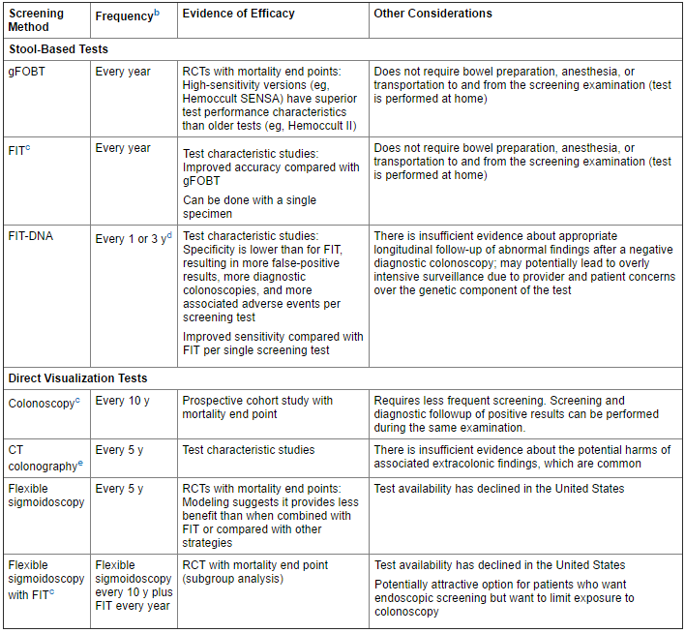
Colorectal Cancer Screening
Notes:
USPSTF and ACS recommendations are the same. :The USPSTF recommends screening for colorectal cancer starting at age 50 years and continuing until age 75 years.
The decision to screen for colorectal cancer in adults aged 76 to 85 years should be an individual one, taking into account the patient’s overall health and prior screening history.
Adults in this age group who have never been screened for colorectal cancer are more likely to benefit.
Screening would be most appropriate among adults who 1) are healthy enough to undergo treatment if colorectal cancer is detected and 2) do not have comorbid conditions that would significantly limit their life expectancy.

Slide 7
Lung Cancer Screening
USPSTF Guidelines:
  Recommends annual screening for lung cancer with low-dose computed tomography (LDCT) in adults aged 55 to 80 years who:
    have a 30 pack-year smoking history and currently smoke or have quit within the past 15 years
    Screening should be discontinued once a person has not smoked for 15 years or develops a health problem that substantially limits life expectancy or the ability or willingness to have curative lung surgery
ACS Guidelines:
  Screening might be right for you if you are ALL of the following:
    55 to 74 years of age
    In good health
    Have at least a 30 pack-year smoking history AND are either still smoking or have quit smoking within the past 15 years
    Screen with annual, low-dose CT (LDCT) scan of the chest

Slide 8
Prostate Cancer Screening
The decision about whether to be screened for prostate cancer should be an individual one. The USPSTF recommends that clinicians inform men ages 55 to 69 years about the potential benefits and harms of prostate-specific antigen (PSA)–based screening for prostate cancer. Screening offers a small potential benefit of reducing the chance of dying of prostate cancer. The USPSTF recommends against PSA-based screening for prostate cancer in men age 70 years and older.
Notes:
-USPSTF draft recommendation
ACS recommendation same
Research has not yet proven that the potential benefits of testing outweigh the harms of testing and treatment.
We believe that men should not be tested without first learning about what we know and don’t know about the risks and possible benefits of testing and treatment
Most concerned about aggressive, over-treatment. We have a hard time distinguishing between aggressive and non-aggressive disease

Slide 9
Questions?

